Slide 1
NLP : Bag Of Words Model
Seif Eddine Khadhraoui

Slide 2
Contents of This Template
Here’s what you’ll find in this template:
A slide structure based on NLP fondamentals in general and BaG Of Words in specefic
Table of Contents
A resources slide, where you’ll find link to Source code and template.

Slide 3
Table of Contents
01
02
03
04
What is NLP
Description of Natural language processing
Bag Of Words
General idea about the term BoW and overview of the dataset
Our model Process
Contains a brief description of the model usage and evaluation later
Source code
Finally the link to the source code

Slide 4
01
NLP
Natural Language processing

Slide 5
Text is everywhere
The usage of documents is a primary information artifact in our lives
The access to documents has greatly grown thanks to the internet
Examples :
Webpages, social media, Wikipedia, reviews and job descriptions
NLP is the quantification of texts into features that we can use later for
Statistic models mainly for training models

Slide 6
The Problem
How to extract information from texts to perform such applications ?
Tone classification
Establish authorship
Classification
Sentiment analysis
(online reviews, twitter, social media)
Authenticy , plagiarism detection
Classification of genres for narratives
Example : books, articles

Slide 7
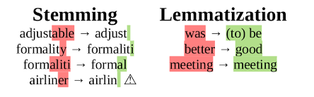
Text preprocessing
Sentence segmentantion
Word tokenization
01
02
separating individual sentences within a given text or document.
identifying and separating words from a given text, taking into account language-specific rules
Stemming
Lemmatization
03
04
Reduce words to their stems (base forms)
doing things properly with the use of a vocabulary and morphological analysis of word

Slide 8
02
BoW
Bag Of Words

Slide 9
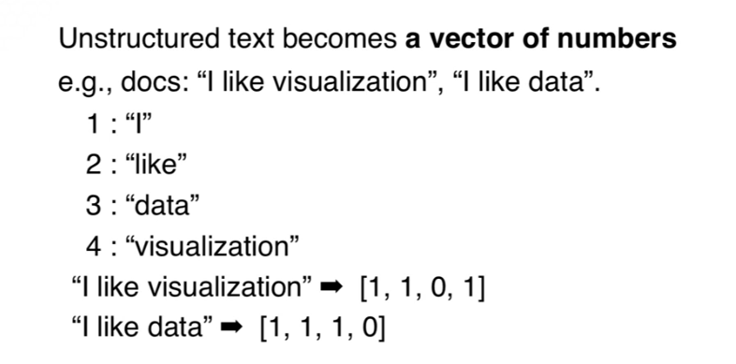
Bag Of Words
Imagine that we have a plastic bag and we place element into it
Bag of words takes any texts and counts the frequency of words
Example :

Slide 10
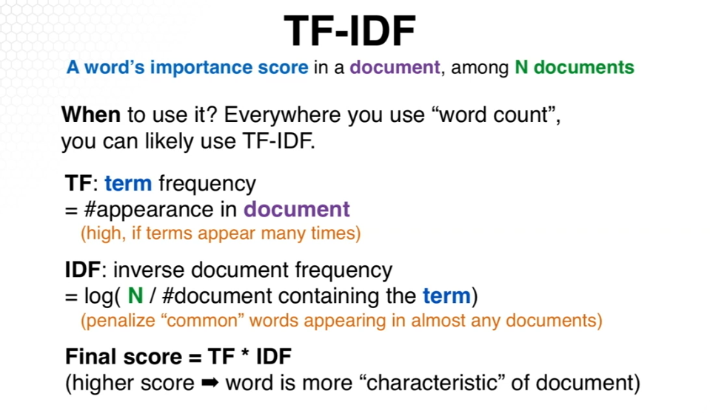
Frequency count
Using TF-IDF

Slide 11
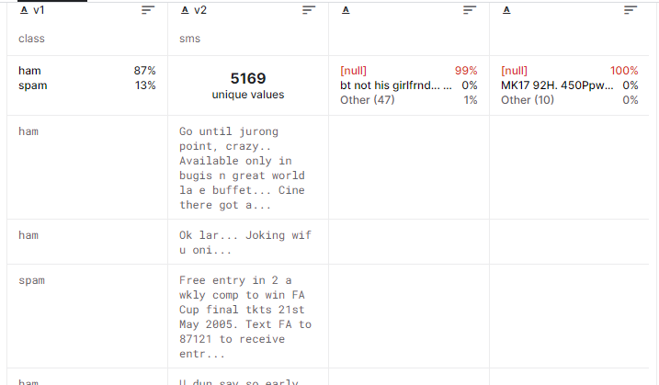
SMS Dataset
Context
The SMS Spam Collection is a set of SMS tagged messages that have been collected for SMS Spam research. It contains one set of SMS messages in English of 5,574 messages, tagged according being ham (legitimate) or spam
Overview :

Slide 12
03
Model process

Slide 13
Model process
Exploring Data
Bag of words model using 2 methods
Step 1
Step2
step 3
step 4
Text preprocessing
Evaluating the model of each method

Slide 14
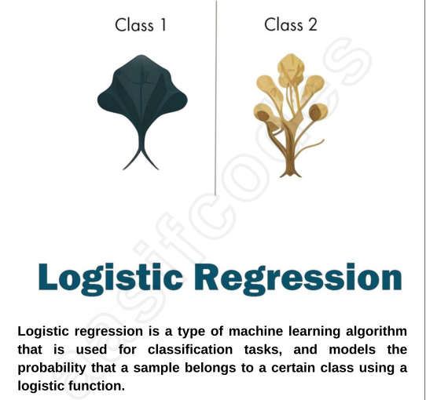
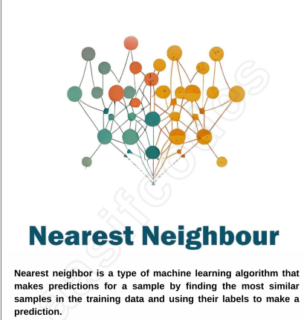
EVALUATION
We evaluate the model using ML Algorithms

Slide 15
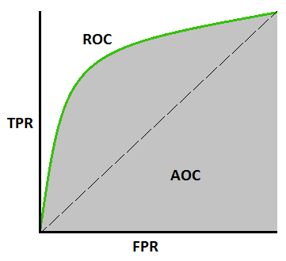
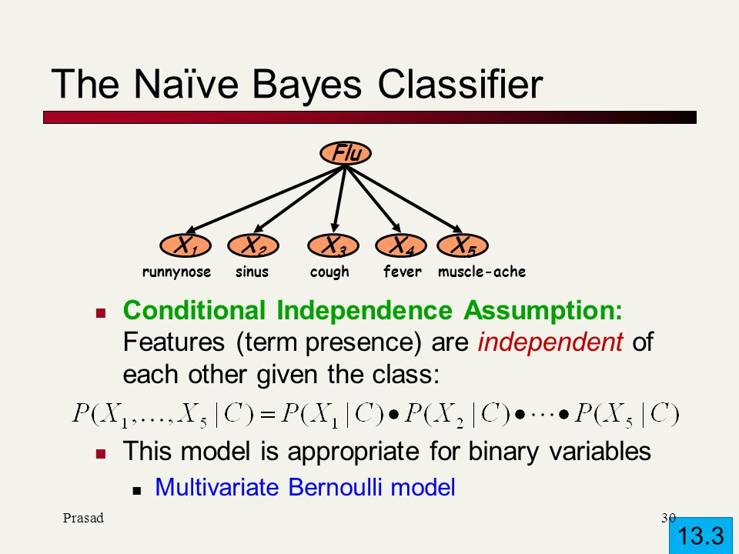
EVALUATION
Area under the ROC CURVE
A performance measurement for classification problem at various thresholds settings

Slide 16
04
Source Code
Source code available at github account
https://github.com/khadhraoui-seifeddine/NLP-Bag-Of-Words

Slide 17
Thanks!
Do you have any questions?
youremail@freepik.com
+91 620 421 838
yourcompany.com
Please keep this slide for attribution

